Slide 1
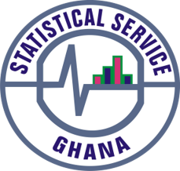
PRESS RELEASE
Ghana, April 2025
CONSUMER PRICE INDEX AND INFLATION
Presented by
Alhassan Iddrisu (PhD)
Government Statistician
7th May 2025

Slide 2
In This Release, We Present:
Introduction
Main Points
Price Drivers
Conclusion
Recommendations
Publications
2

Slide 3
Introduction
Consumer Price Index (CPI) measures changes in the price of a fixed basket of goods and services purchased by households.
It is measured using data on prices of 307 items in the CPI basket purchased by households each month with 2021 as the price reference year or the base year (2021=100).
The price data are captured monthly from 57 markets, 8,337 outlets, and on 47,800 products. The products are ordered into 13 Divisions, 44 Groups, 98 classes, 156 sub-classes and 307 items.
Consumer price inflation is the rate at which the prices of goods and services bought by households rise or fall. It is measured as the percentage change in the CPI between two periods.
Inflation is reported as end-of-period or average
    End-of Period (eop) inflation could be year-on-year (y-on-y), quarter-on-quarter (q-on-q) or month-on-month (m-on-m)
    Average inflation is usually reported as annual average
3

Slide 4
What is New in This Release
In this release, we have introduced:
Annual Average Inflation Data in the COICOP Annexes for April 2025 CPI and Inflation to complement End-of-Period Inflation Data;
Contributions of Divisions/Items to inflation to ease analysis on how each Division or item contributes to inflation rate in a particular period;
Infographics on CPI and Inflation to simplify CPI and Inflation data to make it easier to understand and remember and to communicate the key messages quickly. This will be published along side other inflation data; and
A section on Recommendations in this presentation to provide actionable insights and encourage stakeholder engagement.
4

Slide 5
Main Points: April 2025 CPI and Inflation
CPI for April 2025 was 258.6 up from 256.5 in March 2025 and 213.3 in April 2024.
Year-on-Year (Y-on-Y) rate of inflation for April 2025 was, therefore 21.2%.
This means that on the average, the price of goods and services increased by 21.2% between April 2024 and April 2025, a decrease of 1.2 percentage points compared to inflation in March 2025.
The Month-on-Month (M-on-M) inflation of 0.8% for April 2025 means that prices increased by 0.8% between March and April 2025.
Month | CPI | Inflation
 |  | Y-on-Y | M-on-M
Apr-24 | 213.3 | 25.0% | 1.8%
May-24 | 220.0 | 23.1% | 3.2%
Jun-24 | 226.4 | 22.8% | 2.9%
Jul-24 | 231.0 | 20.9% | 2.1%
Aug-24 | 229.4 | 20.4% | -0.7%
Sep-24 | 235.8 | 21.5% | 2.8%
Oct-24 | 237.8 | 22.1% | 0.9%
Nov-24 | 243.9 | 23.0% | 2.6%
Dec-24 | 248.3 | 23.8% | 1.8%
Jan-25 | 252.6 | 23.5% | 1.7%
Feb-25 | 255.9 | 23.1% | 1.3%
Mar-25 | 256.5 | 22.4% | 0.2%
Apr-25 | 258.6 | 21.2% | 0.8%
5

Slide 6
Main Points: April 2025 CPI and Inflation
No. | Description | Weights | Year-on-Year Inflation (%) |  |  |  | Month-on-Month Inflation (%)
 |  |  | Mar25 | Apr25 | Change |  | Mar25 | Apr25 | Change
1 | National Overview | 100.0 | 22.4 | 21.2 | -1.2 |  | 0.2 | 0.8 | 0.6
2 | Inflation by Food & Non-Food Category
2.1 | Food and Non-Alcoholic Beverages | 42.7 | 26.5 | 25.0 | -1.5 |  | -0.2 | 0.9 | 1.1
2.2 | Non-Food | 57.3 | 18.7 | 17.9 | -0.9 |  | 0.7 | 0.7 | 0.1
3 | Inflation by Imports & Locally Produced Items Category
3.1 | Locally produced Items | 68.5 | 24.0 | 22.7 | -1.3 |  | 0.1 | 1.0 | 0.9
3.2 | Imported Items | 31.5 | 18.7 | 17.7 | -0.9 |  | 0.1 | 0.4 | 0.4
4 | Inflation by Region
4.1 | Lowest regional inflation: Volta Region | 4.5 | 18.9 | 18.3 | -0.6 |  | 1.2 | 1.0 | -0.2
4.2 | Highest regional inflation: Upper West Region | 1.3 | 36.2 | 37.1 | 0.8 |  | 0.9 | 1.2 | 0.3
4.3 | No. of Regions above national average | 35.1 | 9 | 8 | -1.0 |  |  |  | 0.0
4.4 | No. of Regions below national average | 64.9 | 7 | 8 | 1.0 |  |  |  | 0.0
6
Notes:
Ghana’s national inflation slowed to 21.2% in April 2025, driven by a moderation in both food and non-food prices, though food inflation remains elevated at 25.0%.
Regional disparities persist, with the Upper West Region recording the highest inflation (37.1%) and Volta the lowest (18.3%)
Efforts to stabilize prices are showing results, but continued attention is needed on food inflation and regional disparities.

Slide 7
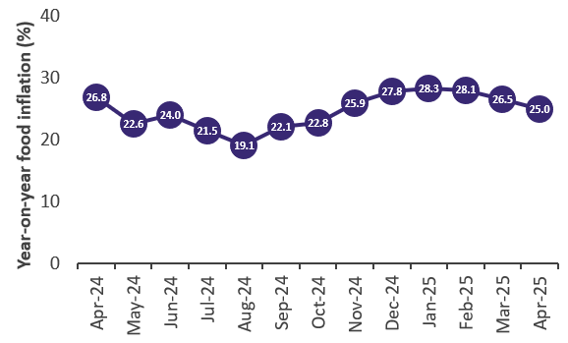
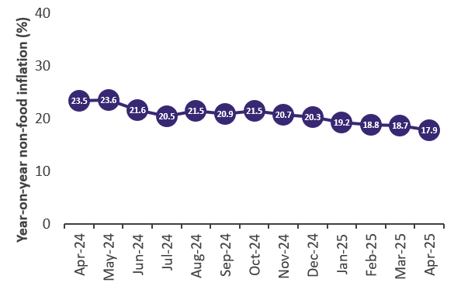
Food and Non-Food Year-on-Year Inflation
Notes:
From the FOOD and NONFOOD perspective,
Year-on-year
Consistent decline since January 2025 in both annual food and non-food inflation
28.3% in January 2025 to 25.0% in April 2025 for food
19.2% January 2025 to 17.9% in April 2025

Slide 8
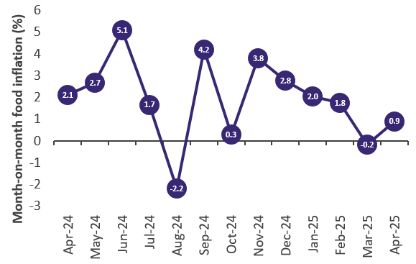
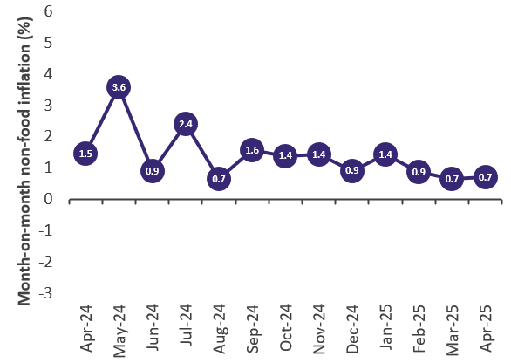
Food and Non-Food Month-on-Month Inflation
Notes:
On a month-on-month basis,
The inflation rate for food declined consistently from 3.8% in November 2024, even recording a deflationary rate of 0.2% in March 2025.
However, April 2025 saw a reversal of this trend, with a uptick to 0.9%.

Slide 9
April 2025 Inflation by Division
No. | Division | Weight |  | Year-on-year inflation (%) |  |  |  | Month-on-month inflation (%)
 |  |  |  | Mar25 | Apr25 | Change |  | Mar25 | Apr25 | Change
1 | Food and non-alcoholic beverages | 42.7 |  | 26.5 | 25.0 | -1.5 |  | -0.2 | 0.9 | 1.1
2 | Alcoholic beverages, tobacco and narcotics | 3.9 |  | 23.8 | 24.0 | 0.2 |  | 0.3 | 1.5 | 1.2
3 | Recreation, sport and culture | 3.5 |  | 20.7 | 22.8 | 2.2 |  | 3.9 | 2.6 | -1.3
4 | Housing, water, electricity, gas and other fuels | 10.2 |  | 25.1 | 22.5 | -2.6 |  | 1.0 | 0.9 | 0.0
5 | Clothing and footwear | 8.0 |  | 19.3 | 19.7 | 0.3 |  | 0.5 | 1.2 | 0.7
6 | Personal care, social protection and miscellaneous goods and services | 2.5 |  | 17.4 | 17.2 | -0.2 |  | 0.6 | 1.1 | 0.5
7 | Insurance and financial services | 0.4 |  | 16.6 | 16.9 | 0.3 |  | 0.4 | 0.7 | 0.3
8 | Furnishings, household equipment and routine household maintenance | 3.2 |  | 15.3 | 15.1 | -0.2 |  | 0.4 | 0.6 | 0.2
9 | Health | 0.7 |  | 16.8 | 15.0 | -1.7 |  | 1.0 | 0.7 | -0.3
10 | Transport | 10.5 |  | 16.8 | 14.9 | -1.9 |  | 0.1 | -0.6 | -0.7
11 | Education services | 6.6 |  | 11.3 | 11.7 | 0.4 |  | -0.1 | 0.6 | 0.7
12 | Information and communication | 3.6 |  | 10.8 | 10.9 | 0.1 |  | 0.1 | 0.4 | 0.3
13 | Restaurants and accommodation services | 4.3 |  | 13.3 | 10.7 | -2.6 |  | 0.4 | -0.1 | -0.5
9
Notes:
Food remains the biggest price driver, though its inflation rate is slowing (It reduced from 26.5% in Mar 2025 to 25.0% in Apr).
Utility and housing costs are easing, offering some relief (its inflation reduced from 25.1% in Mar 2025 to 22.5% in Apr 2025).
Recreation, Sport and Culture saw the highest increase in inflation from 20.7% in Mar to 22.8% in Apr (+2.2%).
Tobacco and alcohol saw the sharpest price spikes in April (an increase from 0.3% in Mar to 1.5 in Apr), which may affect household budgets and consumer behavior.
Transport inflation is cooling, offering relief to households and operational savings for businesses. Its inflation reduced from 16.8% in Mar to 14.9%. On month-on-month basis, we saw a deflation of 0.6% in Apr 2025 down from an inflation rate of 0.1% in Mar 2025.

Slide 10
Contribution to April 2025 Inflation
No. | Division | Weight |  | Contribution
 |  |  |  | Mar25 |  |  |  | Apr25
 |  |  |  | ppt | Cum | cum share |  | ppt | Cum | cum share
1 | Food and non-alcoholic beverages | 42.7 |  | 11.3 | 11.3 | 52.3 |  | 10.7 | 10.7 | 52.0
2 | Housing, water, electricity, gas and other fuels | 10.2 |  | 2.6 | 13.9 | 64.1 |  | 2.3 | 13.0 | 63.1
3 | Clothing and footwear | 8.0 |  | 1.5 | 15.4 | 71.2 |  | 1.6 | 14.6 | 70.8
4 | Transport | 10.5 |  | 1.8 | 17.2 | 79.4 |  | 1.6 | 16.1 | 78.4
5 | Alcoholic beverages, tobacco and narcotics | 3.9 |  | 0.9 | 18.1 | 83.7 |  | 0.9 | 17.0 | 82.9
6 | Recreation, sport and culture | 3.5 |  | 0.7 | 18.8 | 87.0 |  | 0.8 | 17.8 | 86.8
7 | Education services | 6.6 |  | 0.7 | 19.6 | 90.4 |  | 0.8 | 18.6 | 90.6
8 | Furnishings, household equipment and routine household maintenance | 3.2 |  | 0.5 | 20.1 | 92.7 |  | 0.5 | 19.1 | 92.9
9 | Restaurants and accommodation services | 4.3 |  | 0.6 | 20.6 | 95.4 |  | 0.5 | 19.6 | 95.2
10 | Personal care, social protection and miscellaneous goods and services | 2.5 |  | 0.4 | 21.1 | 97.4 |  | 0.4 | 20.0 | 97.3
11 | Information and communication | 3.6 |  | 0.4 | 21.5 | 99.2 |  | 0.4 | 20.4 | 99.2
12 | Health | 0.7 |  | 0.1 | 21.6 | 99.7 |  | 0.1 | 20.5 | 99.7
13 | Insurance and financial services | 0.4 |  | 0.1 | 21.7 | 100.0 |  | 0.1 | 20.6 | 100.0
10
Notes:
The Food and non-alcoholic beverage Division contributed the most (about 52.0%) to Apr 2025
Four Divisions, namely Food and non-alcoholic beverages; Housing, water, electricity, gas, and other fuels; clothing and footwear, and Transport contributed the most (78.4%) to the Apr 2025 Inflation
Health and Insurance & financial services Divisions contributed the least to inflation (0.1% each)
The trend was the same for Mar 2025.

Slide 11
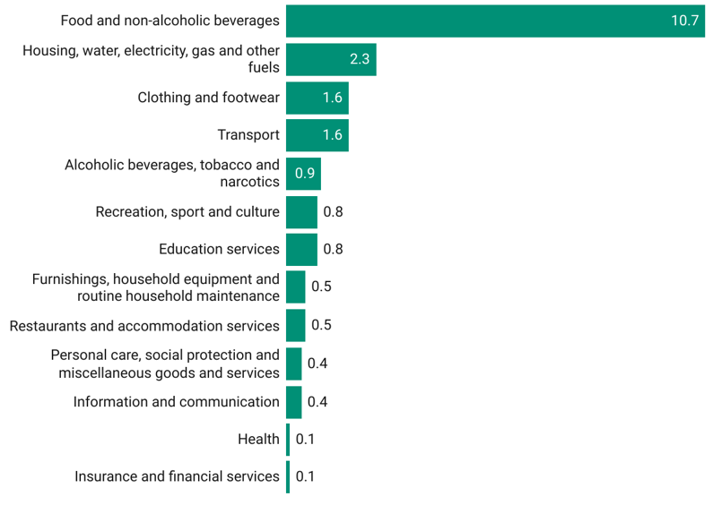
Contribution to April 2025 Inflation (percentage points)
Notes:
Food and non-alcoholic beverages category makeup 10.7 percentage points of the overall year-on-year inflation of 21.2%, which translates into about 52% contribution to April inflation
This is followed by Housing, water, electricity, gas, and other fuels of 2.3 ppt, Clothing and footwears of 1.6 ppt and Transport of 1.6 ppt.

Slide 12
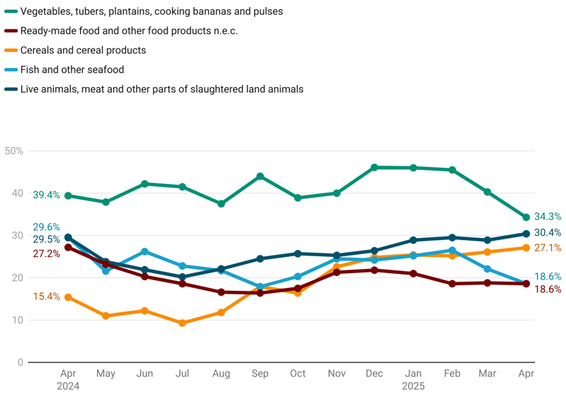
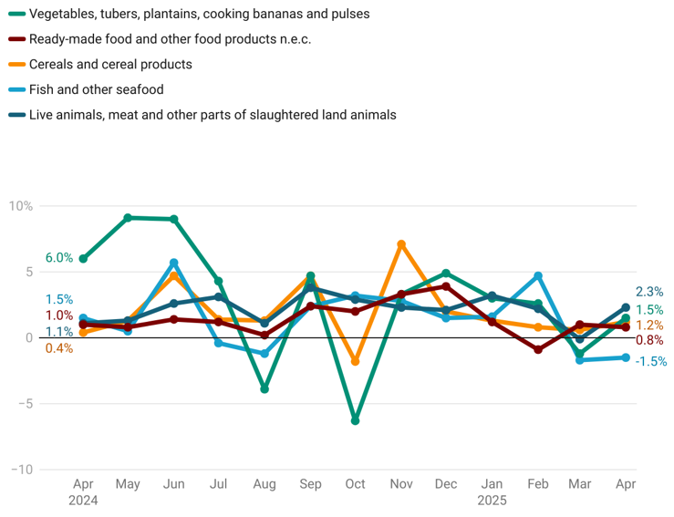
Disaggregation of YoY and MoM Food Inflation by Sub-class
Year-on-year
Rank | Weight
1 | 9.5
2 | 8.0
3 | 7.8
4 | 7.6
5 | 3.2
Month-on-month
12
Notes:
Focusing on the food subclasses, we witnessed mixed dynamics.
The year-on-year inflation rate for live animal, meat and other parts of slaughtered land animals increased consistently from 20.0% in July 2024 to 30.4% in April 2025.
Similarly, cereals and cereal products recorded 27.1% in April 2025, up from a persistent increase of about 10.0% in July 2024.
Vegetable tubers plantain cooking bananas, and pulses category which has a higher weight has consistently decreased since January 2024
The rate for fish and other seafood group follows a similar pattern, declining consistently from 27.0% in February 2025 to 18.6% in April 2025
Except for fish and other seafood which saw a month-on-month deflation rate of 1.5%, the other food categories recorded an increase in the rate between March and April 2025.

Slide 13
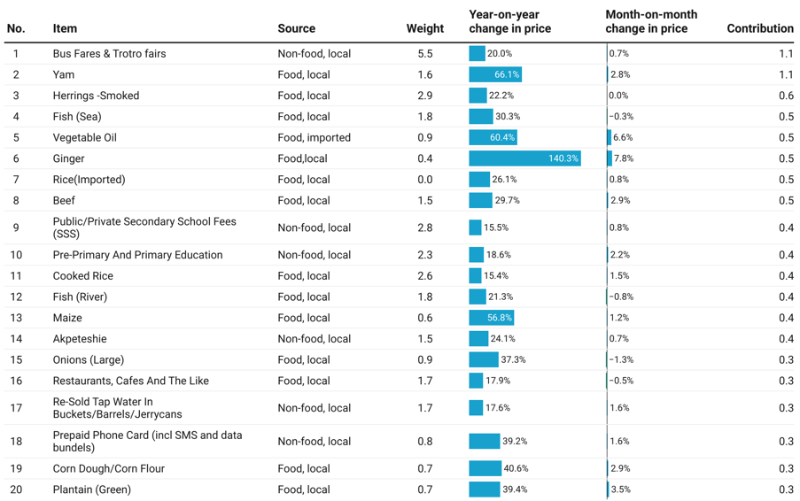
Top 20 Contributions (percentage points) to Inflation
Notes:
Among the top 20 items
Though Yam (66.1%) recorded a lower year-on-year inflation rate compared to Ginger (140.4%) its contribution to the overall inflation for April 2025 is more than two times that of Ginger.

Slide 14
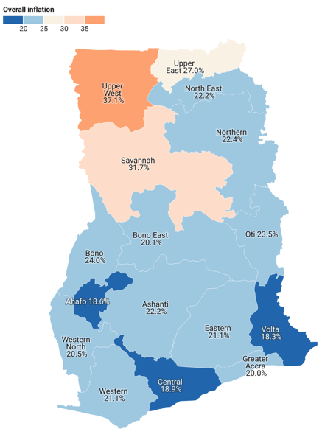
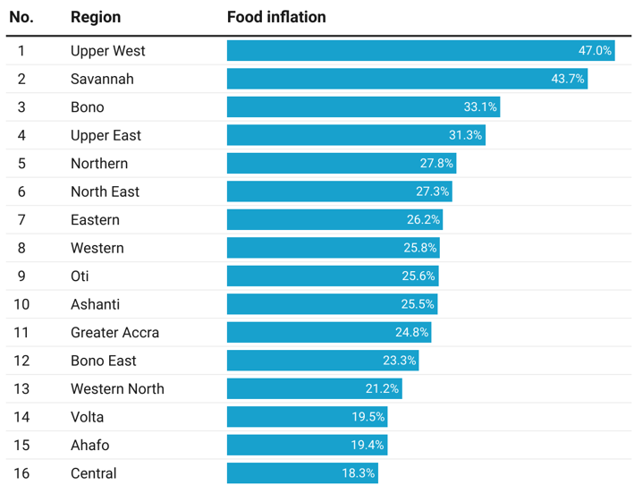
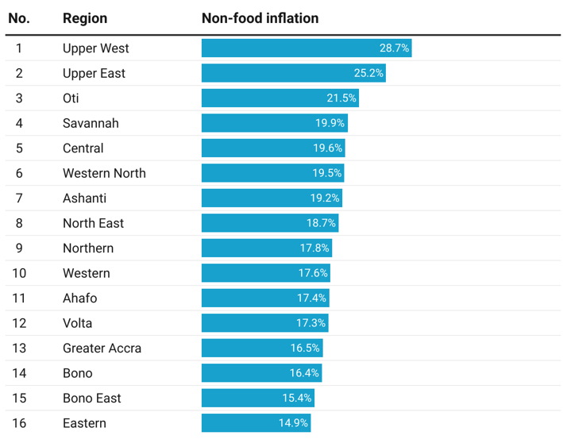
Regional Rates of Inflation for April 2025
14
Notes:
The Upper West Region recorded the highest overall inflation rate of 37.1% in April 2025, while Volta Region had the lowest rate of 18.3%.
Focusing on food inflation, the Upper West Region recorded the highest rate at 47.0%, followed closely by the Savannah Region at 43.7%, while the Central Region recorded the lowest rate at 18.8%.
Similarly, the Upper West Region recorded the highest non-food inflation rate at 28.7%, followed closely by the Upper East Region at 25.2%, while the Eastern Region registered the lowest rate at 14.9%.

Slide 15
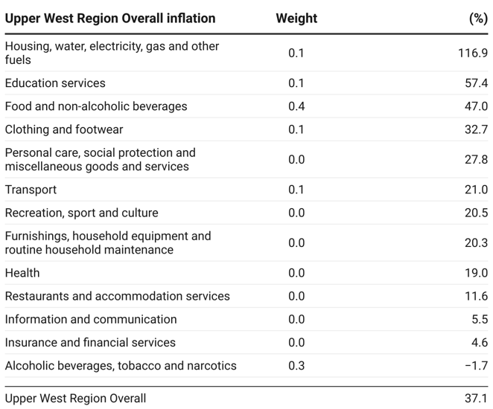
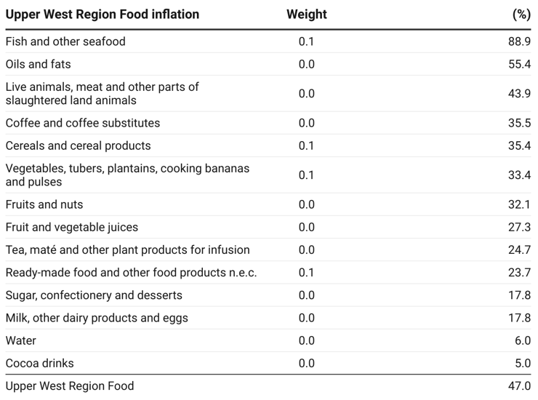
Disaggregation of Overall Inflation and Food Inflation in Upper West Region
Notes:
Housing, water, electricity, gas and other fuels (116.9%); Education services (57.4%); and food and non-alcoholic beverages (47.0%) recorded rates higher than the overall inflation for Upper West Region (37.1%).
Inflation for Fish and other seafood (88.9%) and Oils and fats (55.4%) were higher than overall food inflation for Upper West Region (47.0%).

Slide 16
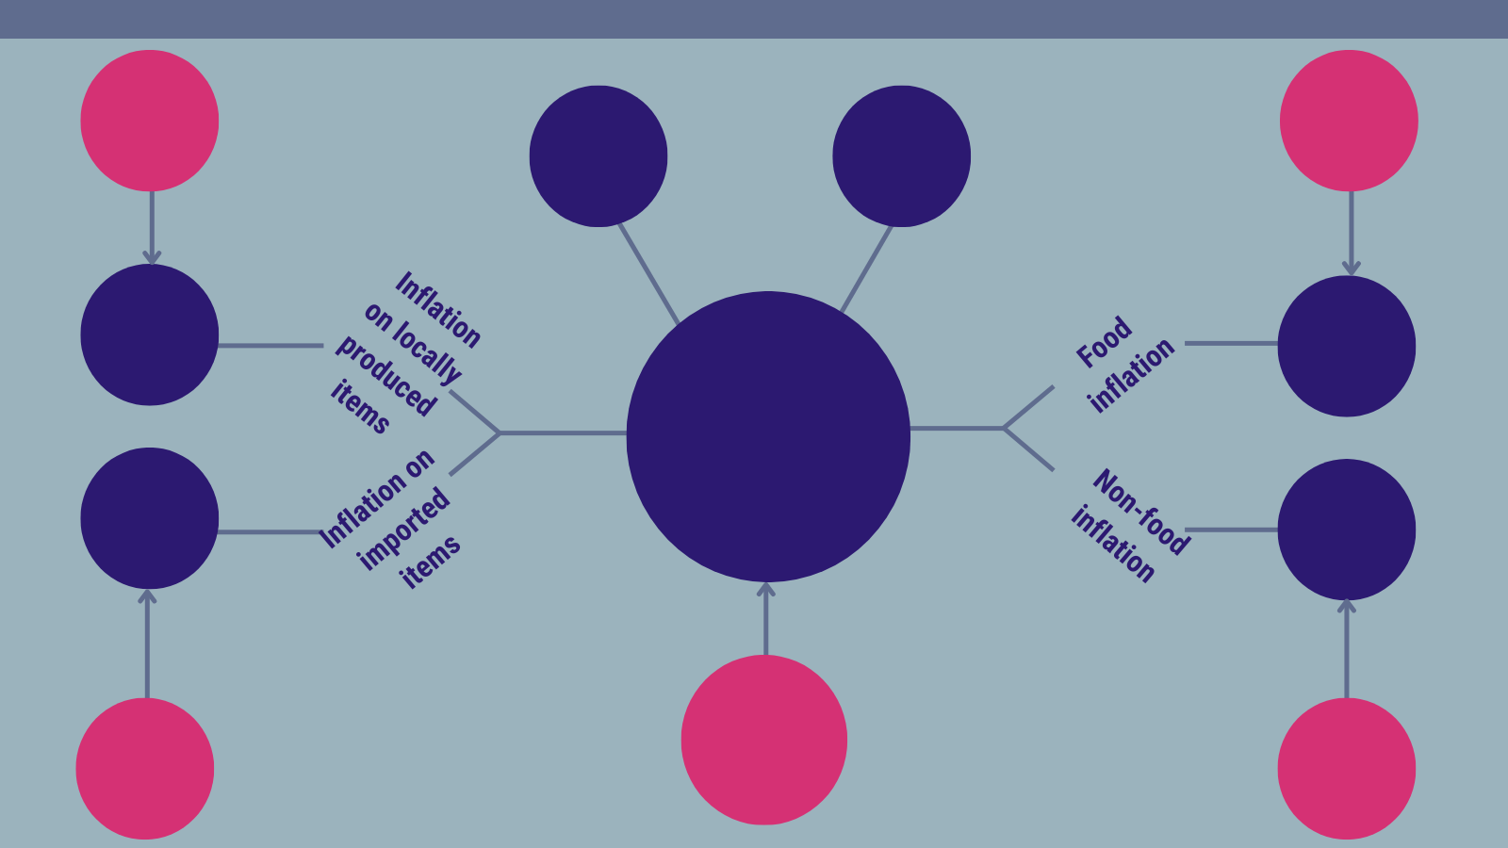
Recap of April 2025 Inflation (Y-on-Y)
24.0%
Inflation on locally produced items
March 2025
26.5%
Food inflation
March 2025
37.1%
Highest regional inflation rate
(Upper West)
18.3%
Lowest regional inflation rate
(Volta)
22.7%
25.0%
21.2%
Year-on-year inflation
April 2025
17.7%
17.9%
22.4%
Year-on-year inflation
March 2025
18.7%
Inflation on imported items March 2025
18.7%
Non-food inflation
March 2025
Notes:
The national year on year inflation rate stood at 21.2% in April 2025, representing a decrease of 1.2 percentage points from the 22.4% recorded in March 2025.
Food inflation stood at 25.0% in April 2025, down from 26.5% in March, indicating a 1.5 percentage point easing in food price pressures compared to last year.
Non-food inflation stood at 17.9% in April 2025, slightly down from 18.7% in March, reflecting a 0.8 percentage point decline.
Inflation rate for locally produced items in April 2025 was 22.7%, down from 24.0% in March 2025.
We observed a one percentage point slowdown in the inflation rate for imported items, from 18.7% in March 2025 to 17.7% in April 2025.
The Upper West Region maintained its position as the region with the highest overall inflation rate, recording 32.7% in April 2025
Similarly, the Volta Region recorded the lowest inflation rate at 18.3%.

Slide 17
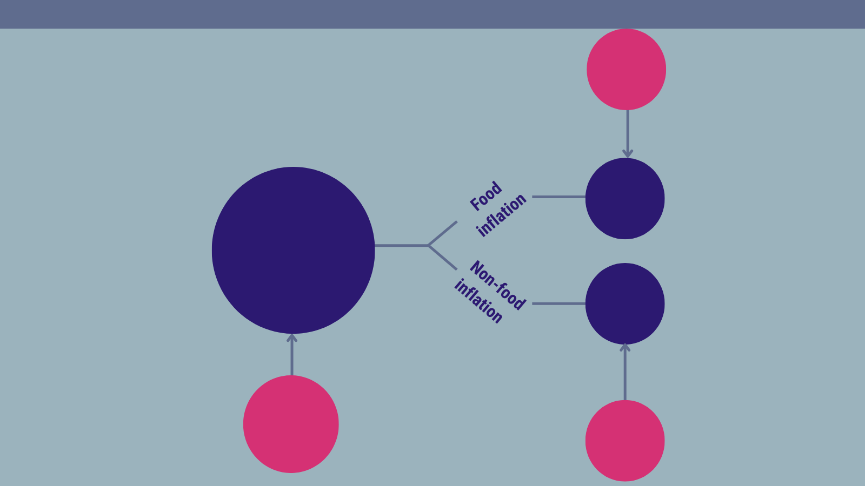
Recap of April 2025 Inflation (M-on-M)
-0.2%
Food inflation
March 2025
0.9%
0.8%
Month-on-month inflation
April 2025
0.7%
0.2%
Month-on-month inflation
March 2025
0.7%
Non-food inflation
March 2025
Notes:
The national month-on-month inflation rate stood at 0.8% in April 2025, representing a decrease of 1.2 percentage points compared with the 0.2% recorded in March 2025.
Food inflation accelerated by 1.1 percentage points to reach 0.9% in April 2025, following a deflationary rate of 0.2% in March 2025, indicating renewed food price pressures.

Slide 18
Conclusion
The year-on-year inflation rate in April 2025 stood at 21.2%, a decline from 22.4% in March 2025, marking the 5th consecutive monthly decline.
This sustained drop is a positive signal of moderating inflationary pressures.
However, a month-on-month increase to 0.8%, following the 0.2% in March, suggests that vigilance is still required to tame inflation.
The overall outlook is cautiously optimistic, with opportunities to consolidate gains and enhance economic resilience.
18

Slide 19
Recommendations
For Households:: Continue to manage expenditures cautiously and remain responsive to changes in prices of items such as food and transport, which have shown volatility.
For Businesses: Take advantage of easing cost pressures to rebuild margins or provide price relief to consumers, especially in sectors heavily reliant on transport and imported goods such as food and restaurants & accommodation services.
For Government:
    Sustain macroeconomic stability measures to reinforce the downward inflation trend;
    Sustain the social intervention programmes such as the LEAP, Capitation Grant, School Feeding Programme, the NHI Programme and new SIPs to protect the real incomes of the poor;
    Monitor supply chains and food markets closely, especially high-inflation commodities like ginger, beans, and vegetable oil.
    Fastrack the implementation of the Agriculture for Transformation Programme to reduce food inflation, particularly on vegetables, tubers, plantains which has a high weight (9.5) in the CPI basket.
    Strengthen public education on inflation dynamics to promote informed household decision-making.
19

Slide 20
Publications
Power Point Presentation on April 2025 Inflation
April 2025 CPI Bulletin
COICOP Annexes for April 2025 CPI
Infographics for April 2025 CPI and Inflation
20

Slide 21
End of Press Release for
April 2025 Consumer Price Index
For enquiries, please contact:
Mr. J. F.K. Agyaho
(Head, Price Statistics, GSS)
john.agyaho@statsghana.gov.gh
Download the technical guide:
https://statsghana.gov.gh/gssmain/fileUpload/Price%20Indices/CPI_Technical_Guide_v5_Published_14102020.pdf

Slide 22
Consumer Price Index and Inflation
April 2025

